Slide 1
Word2Vec

Slide 2
One-hot encoding
Embedding Matrix - Embedding Vector
Linear model
Softmax function
Input - Output
Skip-gram (N-gram)
Continuous Bag of words (CBOW)

Slide 3
Embedding Matrix
Softmax function
Embedding Vector
Linear model
Word
(One-hot
encoding)
Word
(Prob)
Hidden layer
Input layer
Output layer
Notes:
Input: 輸入某個字
Output輸出是一個概率，代表我們在詞庫裡看到的每個詞有多大的可能性與input word 同時出現
而最後的softmax是一個概率函數，能夠將數值縮放在0~1之間
對於word2vec來說，最後要求得的就是embedding matrix以及linear model裡面的參數

Slide 4
One-hot encoding
Bird
Fly
Dog
Run
1
0
0
0
0
1
0
0
0
0
1
0
0
0
0
1

Slide 5
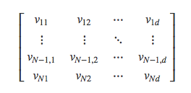



Embedding Matrix
Input vector
d
Lookup
1 x N
N
0
0
1
0
Embedding Vector
Generated by tf.random_uniform
from -1 to 1
1 x d
Notes:
Input vector是一個N維向量，input vector會跟embedding matrix做矩陣相乘
這個embedding matrix是一個N by d維

Slide 6

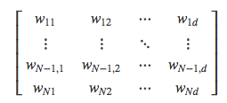


Linear model
Embedding Vector
1 x d
d
N

Slide 7
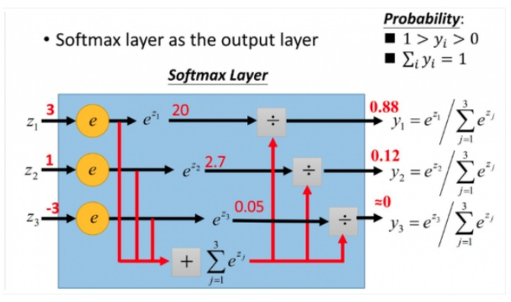
https://www.youtube.com/watch?v=hSXFuypLukA
Notes:
softmax function是用在multi-class classification problem上

Slide 8
Generated by 1-gram
Center Word
Context Words
(Bird, Fly)
1
0
0
1
Loss
0
0
0
0
Notes:
在word2vec的input與output是怎麼產生的呢？

Slide 9
Skip-gram
Training
Samples
Text
(Input, Output)
Birds fly across oceans.
(Birds, fly)
(Birds, across)
(fly, Birds)
(fly, across)
(fly, oceans)
Birds fly across oceans.
(across, Birds)
(across, fly)
(across, oceans)
Birds fly across oceans.
Birds fly across oceans.
(oceans, fly)
(oceans, across)

Slide 10







Skip-gram

Slide 11
Continuous Bag of Words
Training
Samples
Text
Birds fly across oceans.
Input: (Birds, across)
Output: fly
Birds fly across oceans.
Input: (fly, oceans)
Output: across

Slide 12








CBOW

Slide 13
English vocabulary：3 million
Chinese vocabulary：200,000
Vocabulary：10,000
Combine common ‘word pairs’ as a ‘word’
Subsampling of Frequent Words
Negative sampling
Embedding Vector：300
Weights：3 million
Distributed Representations of Words and Phrases and their Compositionality：https://arxiv.org/pdf/1310.4546.pdf

